Slide 1
Garbage classification using Deep Learning
“An AI-Powered System to Identify and Classify Household Waste Materials”

Slide 2
Project Description
In this project, we aim to develop a sophisticated garbage classification system leveraging the EfficientNetV2B2 architecture. Our primary dataset serves as a foundation for building models that can eventually automate waste segregation, a critical step in optimizing recycling and waste management, ultimately aiding in environmental conservation.
Goal: To develop an accurate and efficient garbage classification model using EfficientNetV2B2 and transfer learning for automated waste sorting.

Slide 3
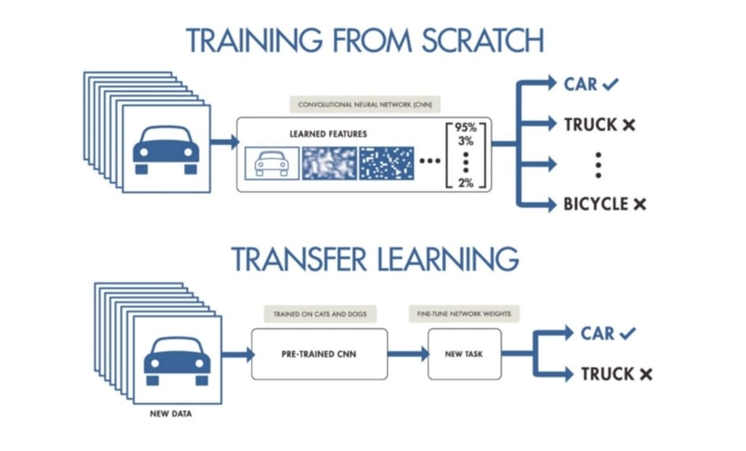
Challenges and Scope
Key Challenge: A notable challenge encountered is the inherent class imbalance within the dataset.

Slide 4
Transfer Learning is a machine learning technique where a pre-trained model developed for a specific task is reused as the starting point for a model on a different but related task. It also allows us to build accurate models in a time-saving way by starting from patterns learned when solving a different problem. This approach is beneficial when there is limited data for the new task, as the pre-trained model already has learned features that can be adapted. Transfer learning can significantly improve models' performance and efficiency in domains like computer vision and natural language processing.
Benefits
Reduces training time — you don't start from scratch.
Leverages learned features from large datasets (like ImageNet).
Improves performance, especially with limited data.

Slide 5
How Does It Work?
Load a pretrained model (e.g., ResNet, EfficientNet).
Freeze the pretrained layers (optional).
Add new layers for your custom task.
Train on your new dataset (can also fine-tune).
Image Dataset: Garbage images are collected and categorized (Plastic, Glass, Organic, etc.).
Preprocessing: Images are resized (224x224), normalized, and augmented.
Transfer Learning: MobileNetV2 model is used with custom classification layers.
Training: Model is trained using labeled images to learn different garbage types.
Prediction: New images are given to the model, and it predicts the garbage type.
Use Case: Can be used in smart bins, recycling plants, or waste-sorting apps.
EfficientNetV2B2: Transfer Learning Backbone
EfficientNetV2B2 is a mid-sized model from the EfficientNetV2 family developed by Google, balancing performance and efficiency.

Slide 6
Key feature:
1. Transfer Learning Based:
Uses pretrained MobileNetV2 model, which makes training faster and more accurate even with a small dataset.
2. Multi-Class Classification:
Capable of classifying garbage into multiple categories like Plastic, Metal, Glass, Paper, etc.
3. High Accuracy:
Achieves good accuracy with limited training, thanks to data augmentation and deep learning techniques.
4. Real-Time Prediction:
Can classify new images in real-time, making it suitable for practical applications like smart bins.
5. Easy Deployment:
The model can be deployed on web apps, mobile apps, or even embedded systems (like Arduino or Raspberry Pi).
6. Promotes Sustainability:
Helps in reducing manual effort and supports better waste segregation and recycling.

Slide 7
Why Use EfficientNetV2B2?
1. High Accuracy with Fewer Parameters
EfficientNetV2B2 balances performance and speed. It achieves high accuracy without making the model unnecessarily large.
2. Faster Training
Compared to older models like ResNet or VGG, EfficientNetV2 series trains faster and needs fewer resources (good for Google Colab).
3. Lower Computational Cost
It uses optimized blocks and compound scaling, which means less memory and faster predictions — ideal for low-power devices.
4. Better Generalization
EfficientNetV2 handles noise and variability in image data better, making it great for messy data like garbage classification.
5. State-of-the-Art Transfer Learning
Pretrained EfficientNetV2 models are available on ImageNet and integrate easily with TensorFlow/Keras.

Slide 8
Core Libraries
tensorflow: For deep learning model building and training.
numpy: For numerical operations and array manipulation.
matplotlib.pyplot: For plotting training curves and results.
Some image samples of garbage classification
“These are sample images used to train and test the garbage classification model. Each image belongs to a specific category such as plastic, glass, metal, organic, paper, or cardboard. The model learns to identify patterns in these images to classify them accurately.”

Slide 9
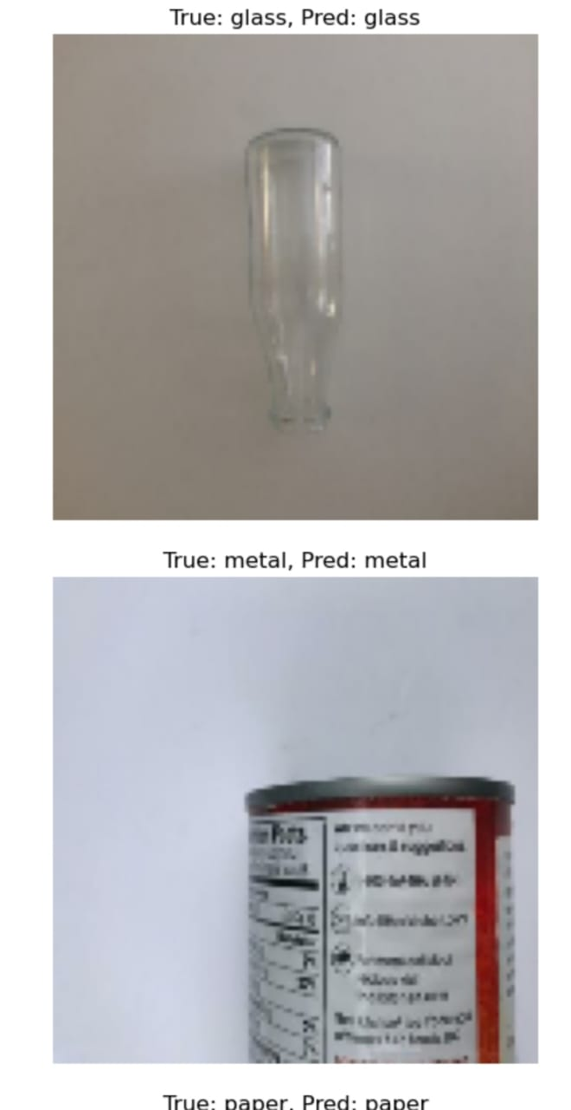

Slide 10
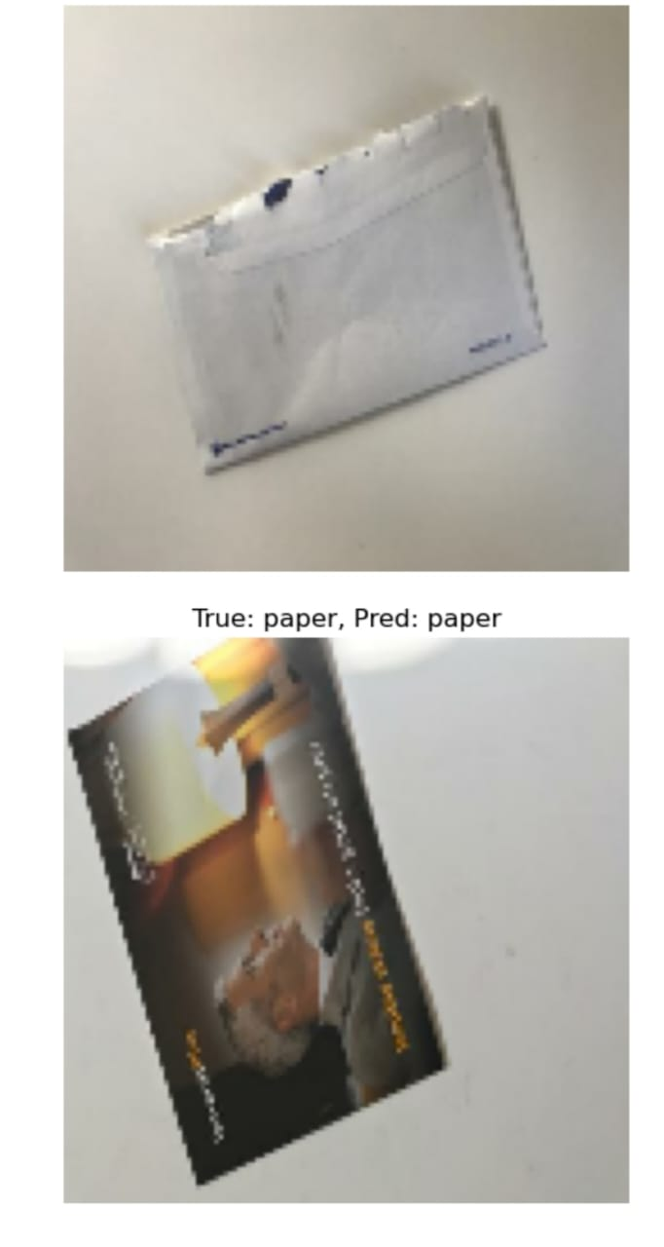

Slide 11
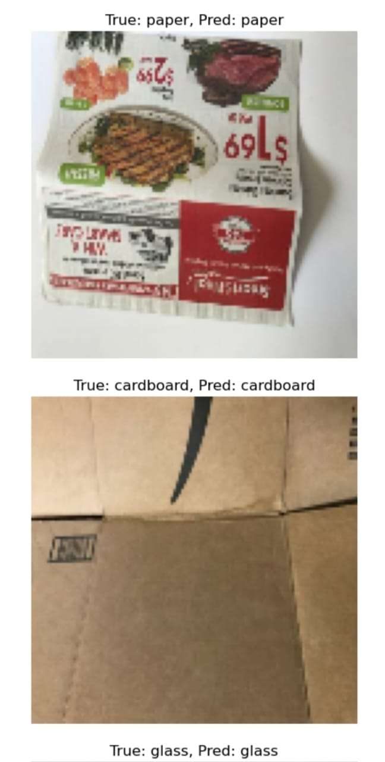

Slide 12
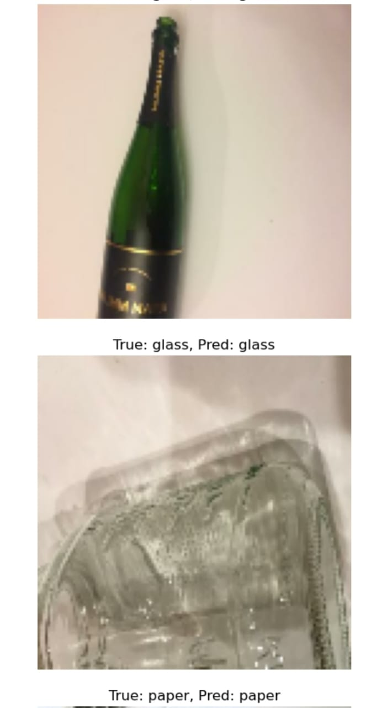

Slide 13
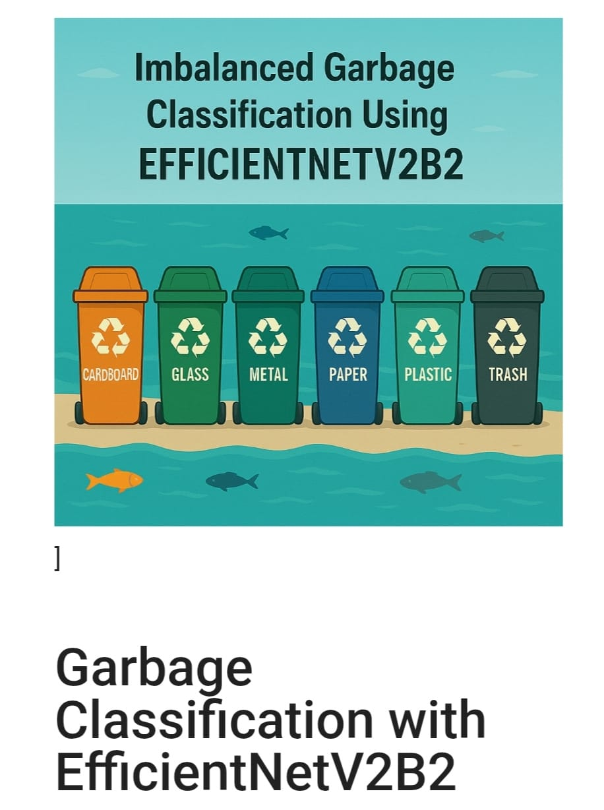

Slide 14
Code section
# Import necessary libraries
import tensorflow as tf
from tensorflow.keras.applications import MobileNetV2
from tensorflow.keras.models import Model
from tensorflow.keras.layers import Dense, GlobalAveragePooling2D, Dropout
from tensorflow.keras.preprocessing.image import ImageDataGenerator
# Step 1: Load the Pretrained MobileNetV2 Model
base_model = MobileNetV2(input_shape=(224, 224, 3), include_top=False, weights='imagenet')
# Step 2: Freeze the base model layers
for layer in base_model.layers:
layer.trainable = False
# Step 3: Add custom layers on top
x = base_model.output
x = GlobalAveragePooling2D()(x)
x = Dropout(0.3)(x)
x = Dense(128, activation='relu')(x)
x = Dropout(0.3)(x)
predictions = Dense(6, activation='softmax')(x)
# Step 4: Create final model
model = Model(inputs=base_model.input, outputs=predictions)
# Step 5: Compile the model
model.compile(optimizer='adam',
loss='categorical_crossentropy’,
metrics=['accuracy'])

Slide 15
Step 6: Data Preprocessing and Augmentation
train_datagen = ImageDataGenerator(rescale=1./255,
shear_range=0.2,
zoom_range=0.2,
horizontal_flip=True,
validation_split=0.2)
train_generator = train_datagen.flow_from_directory(
'/content/drive/MyDrive/Garbage_Dataset',
target_size=(224, 224),
batch_size=32,
class_mode='categorical',
subset='training'
)
val_generator = train_datagen.flow_from_directory(
'/content/drive/MyDrive/Garbage_Dataset',
target_size=(224, 224),
batch_size=32,
class_mode='categorical',
subset='validation'
)
# Step 7: Train the Model
model.fit(train_generator,
validation_data=val_generator,
epochs=10)

Slide 16
Model Deployment
The trained garbage classification model can be deployed using:
Web Apps (using Flask or Streamlit)
Mobile Apps (using TensorFlow Lite)
IoT Devices (like Raspberry Pi for smart bins)
Users can upload an image, and the model will predict the type of garbage in real-time.
✅ Helps automate waste segregation in smart cities and homes.

Slide 17
Conclusion
This project demonstrates the successful application of deep learning, particularly transfer learning using EfficientNetV2B2 or MobileNetV2, for automatic garbage classification. By training the model on a diverse dataset of waste images, the system is capable of identifying multiple types of garbage such as plastic, glass, metal, paper, and organic waste with good accuracy.
The implementation of this model promotes faster and more accurate waste segregation, which can be beneficial in smart city projects, recycling plants, and even household-level waste management systems. With proper deployment using web or mobile applications, this model can be integrated into smart bins or used as an educational and environmental tool.
In conclusion, the project not only helps in reducing human effort but also supports environmental sustainability by encouraging efficient recycling. Future enhancements may include real-time object detection, edge-device deployment, and multilingual user interfaces to make the system more accessible and practical for wider use.
This AI-driven system brings us one step closer to cleaner, greener, and smarter cities.

